Slide 1

Hello!
I am Arshak Rezvani
You can find me at @ArshakRz

Slide 2

Comparison of Multi-Channel EEG Based Graph Learning Methods
Supervisor: Dr. Mohammad B. Shamsollahi
Tutor: Dr. Mohammad Memarian
#WomanLifeLiberty

Slide 3
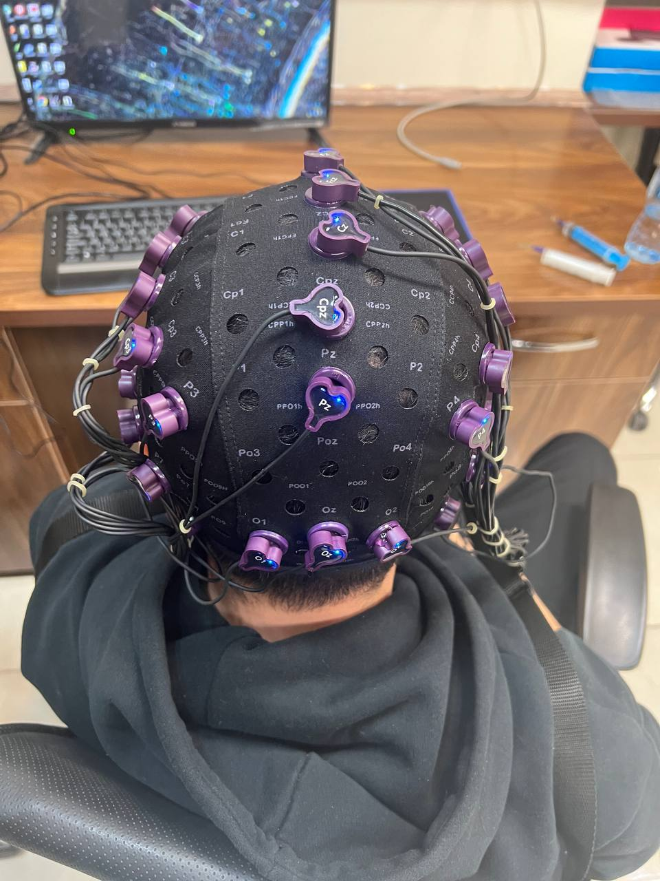
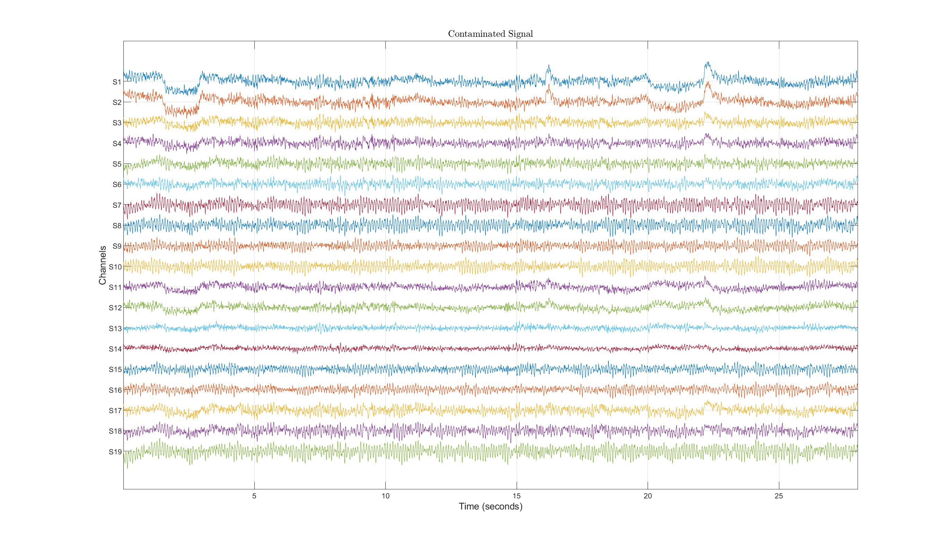
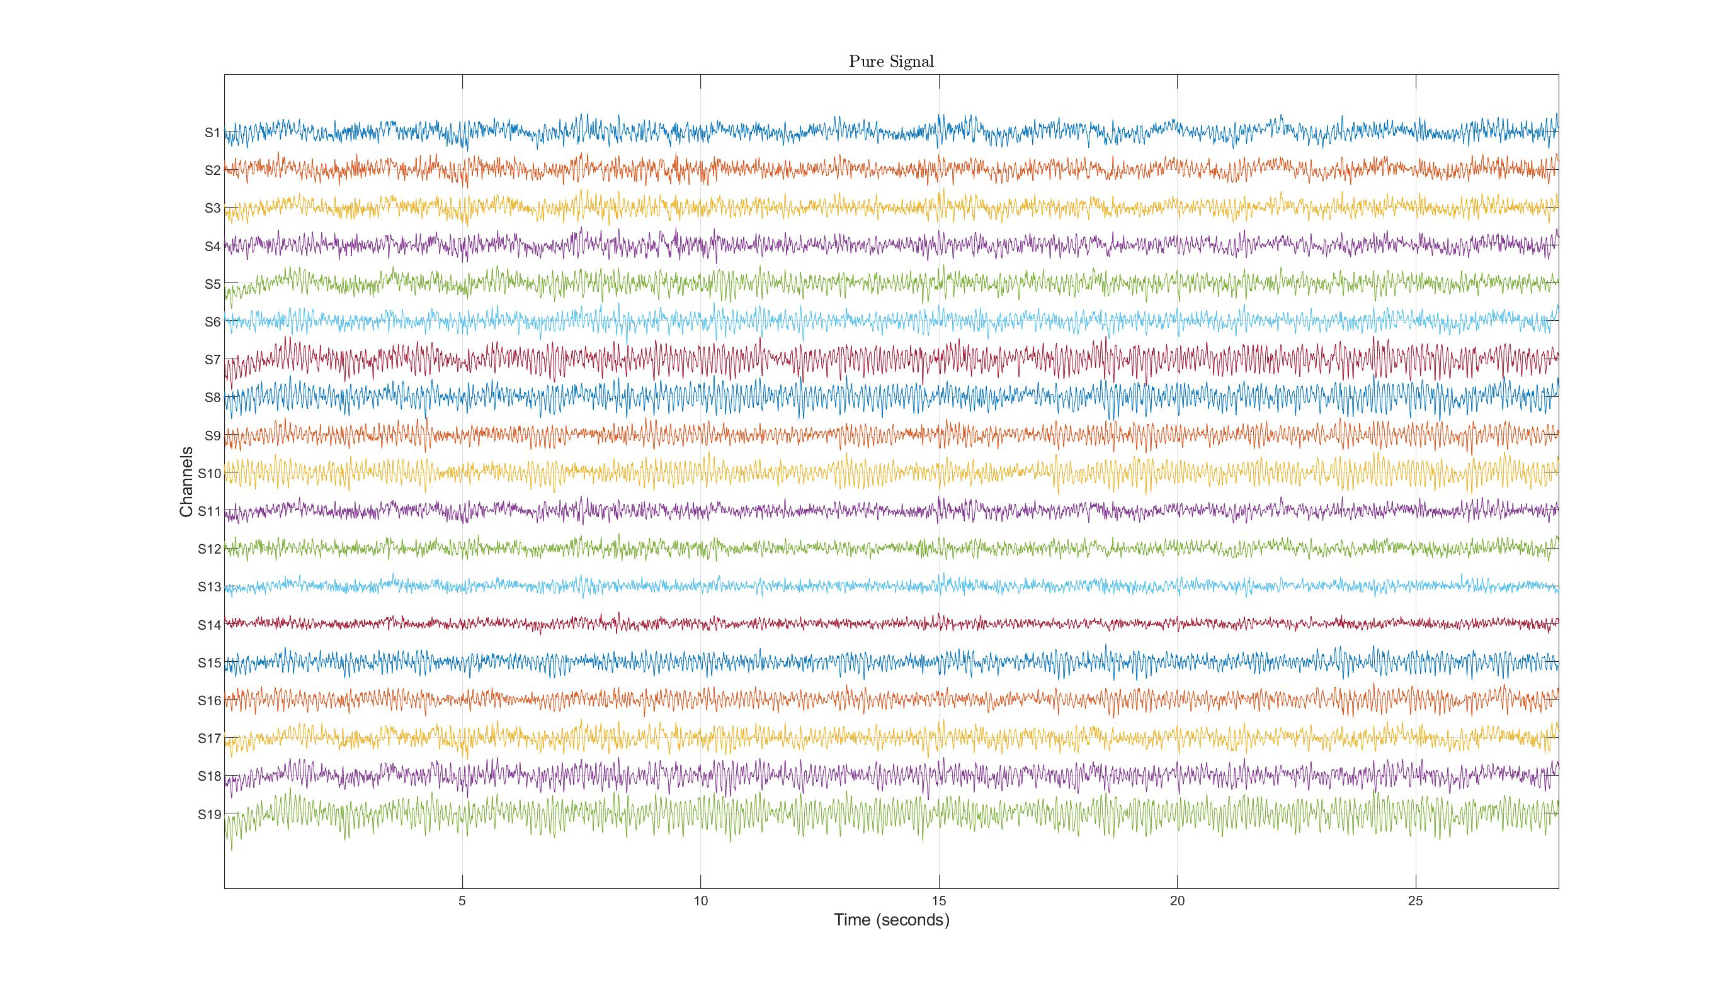
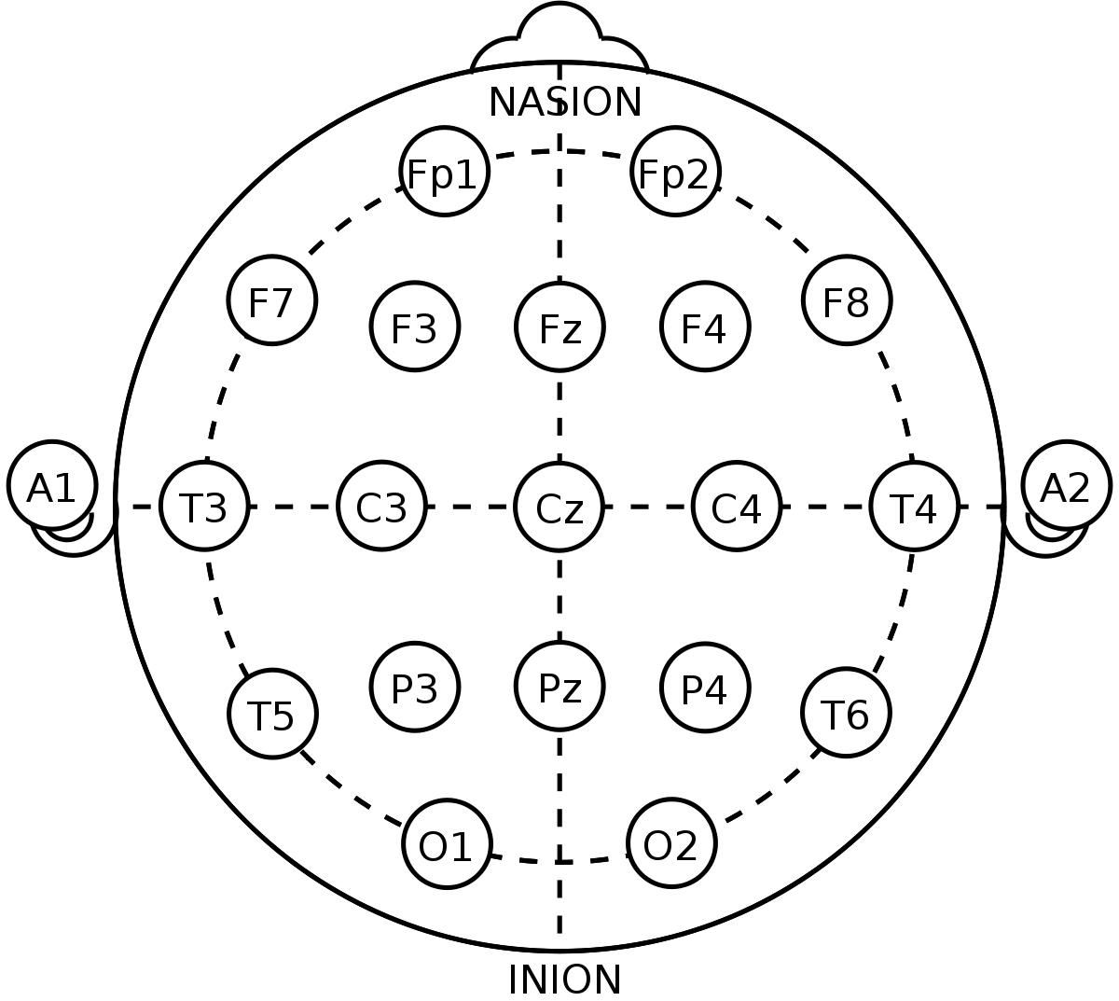
What is a Multi-Channel EEG Signal? [1]
Electrode placement systems.
The 10-20 System of Electrode Placement
Electroencephalogram Time Series and Channels.
Like Noise!
Pre-Processing
Artifact Rejection
ICA or GEVD
Makoto Pipeline

Slide 4
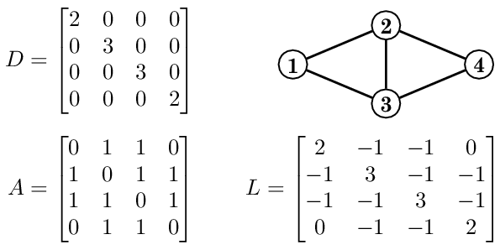
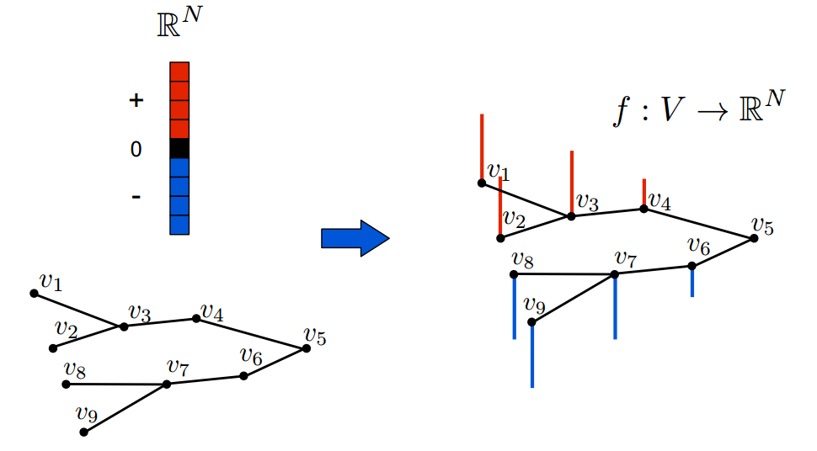
But What is a Graph Signal? [2]
Graph Representations
Adjacency Matrix
Laplacian Matrix
A Vector on a Graph!

Slide 5
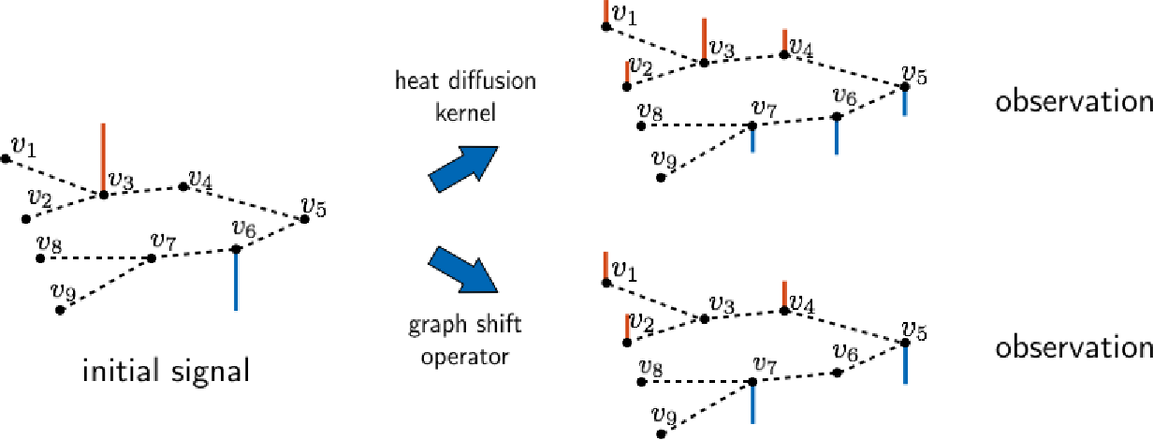
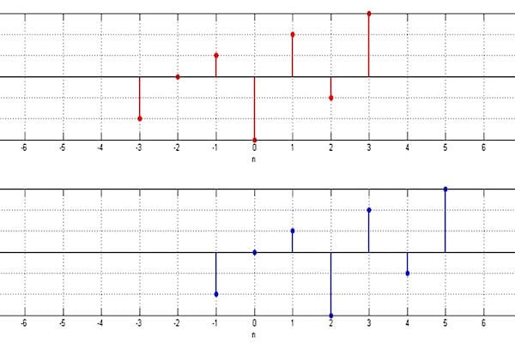
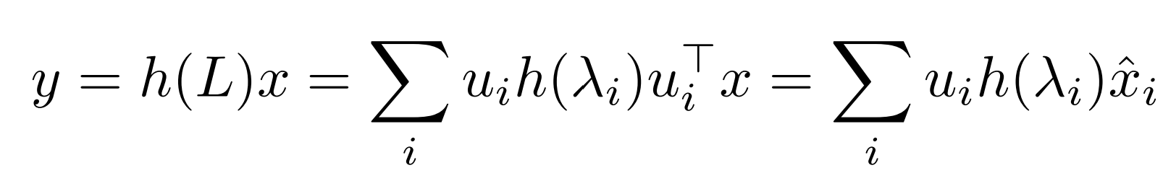
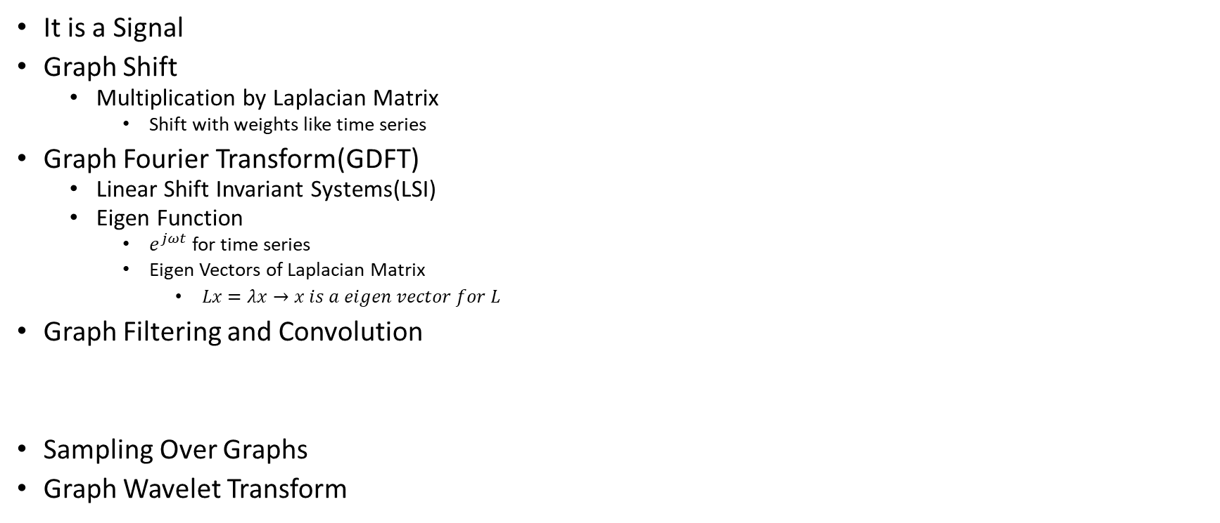
Graph Operations [2]
It is a Signal
Graph Shift
Multiplication by Laplacian Matrix
Shift with weights like time series
Graph Fourier Transform(GDFT)
Linear Shift Invariant Systems(LSI)
Eigen Function
$e^{jωt}$ for time series
Eigen Vectors of Laplacian Matrix
$Lx=λx→x is a eigen vector for L$
Graph Filtering and Convolution
Sampling Over Graphs
Graph Wavelet Transform
Initial Signal
Shifted Signal

Slide 6
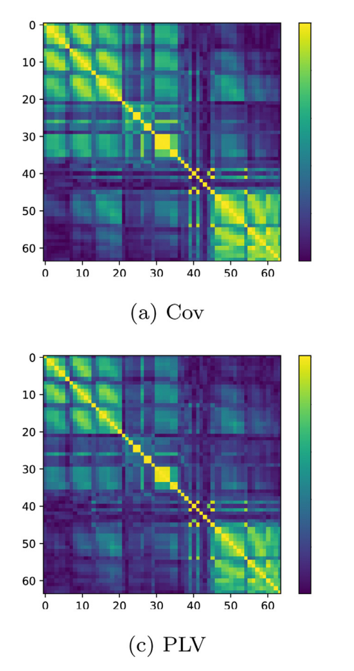
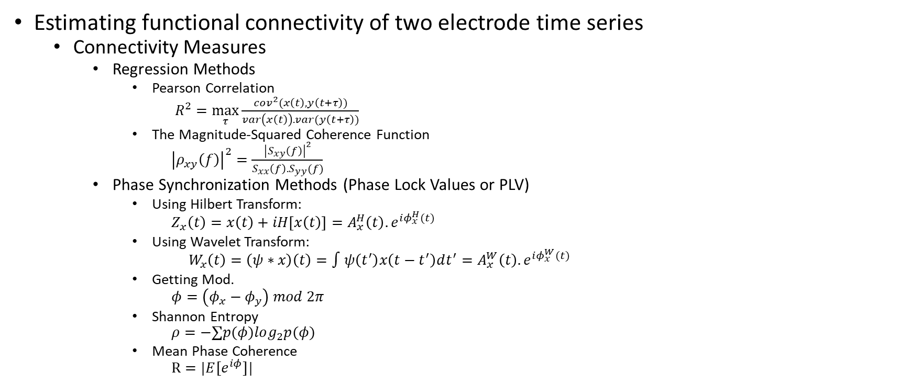
Graph Learning [3][17]
Estimating functional connectivity of two electrode time series
Connectivity Measures
Regression Methods
Pearson Correlation
$R^{2}=\max_{τ}{\frac{cov^{2}(x\left(t\right),y\left(t+τ\right))}{var\left(x\left(t\right)\right).var(y\left(t+τ\right))}}$
The Magnitude-Squared Coherence Function
${\left|ρ_{xy}\left(f\right)\right|}^{2}=\frac{{\left|S_{xy}\left(f\right)\right|}^{2}}{S_{xx}\left(f\right).S_{yy}(f)}$
Phase Synchronization Methods (Phase Lock Values or PLV)
Using Hilbert Transform:
$$Z_{x}\left(t\right)=x\left(t\right)+iH\left[x\left(t\right)\right]=A_{x}^{H}\left(t\right).e^{iφ_{x}^{H}(t)}$$
Using Wavelet Transform:
$$W_{x}\left(t\right)=\left(ψ∗x\right)\left(t\right)=∫ψ\left(t^{′}\right)x\left(t−t^{′}\right)dt^{′}=A_{x}^{W}\left(t\right).e^{iφ_{x}^{W}(t)}$$
Getting Mod.
$$φ=\left(φ_{x}−φ_{y}\right) mod 2π$$
Shannon Entropy
$$ρ=−∑p(φ)log_{2}p(φ)$$
Mean Phase Coherence
$$R=|E[e^{iφ}]|$$

Slide 7
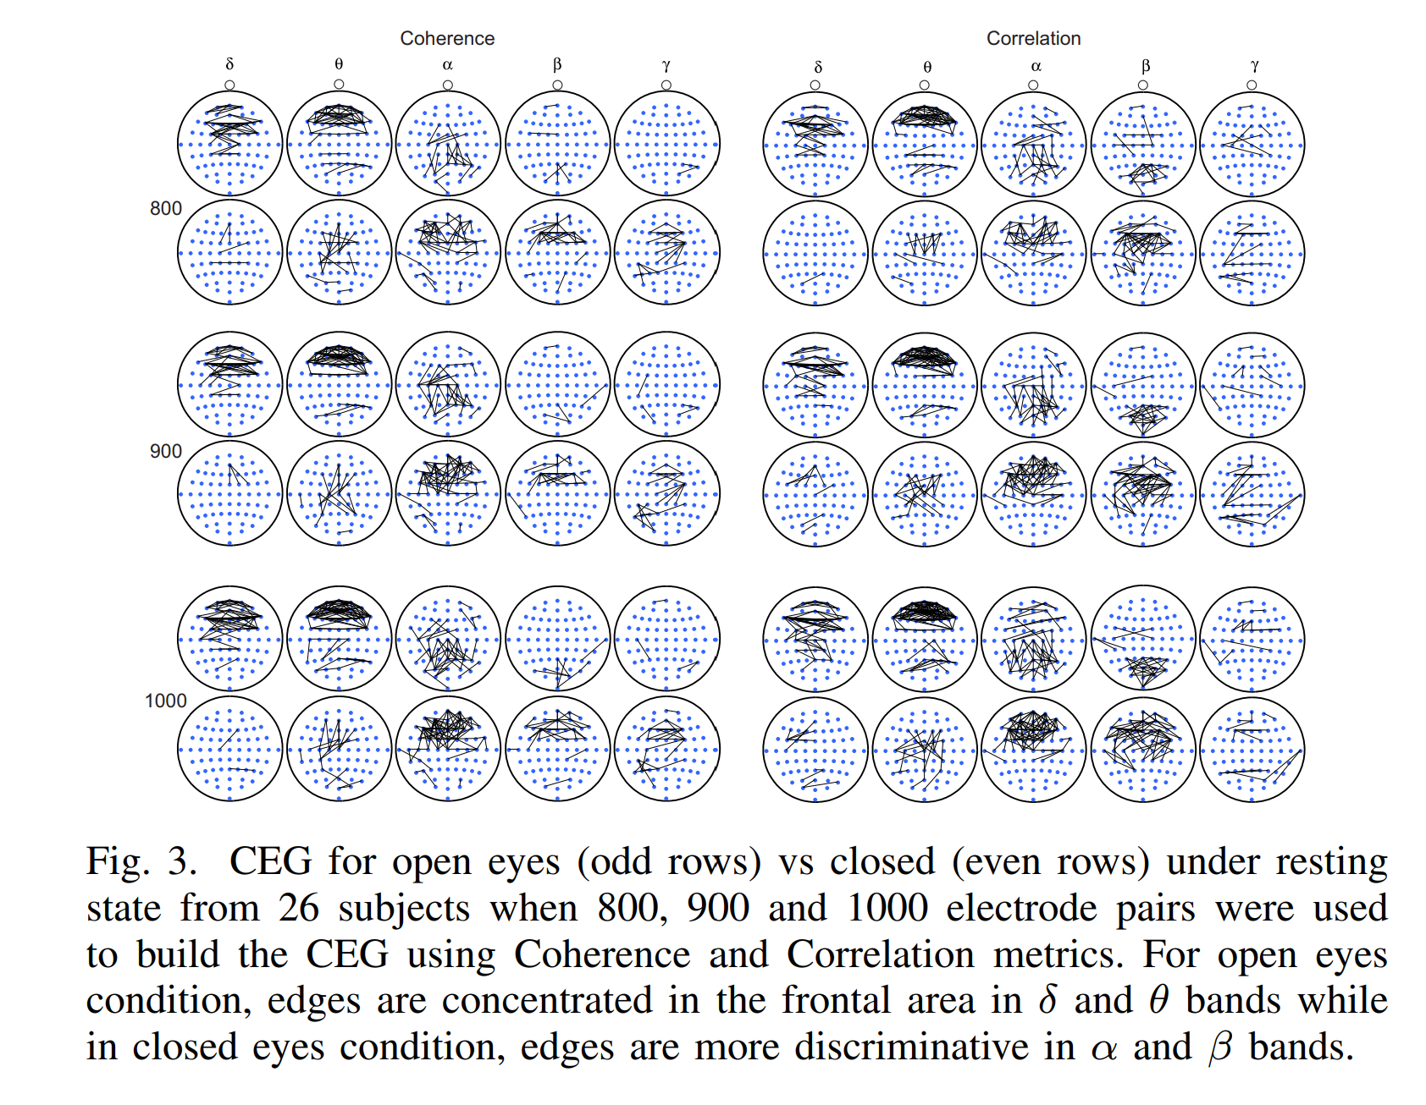
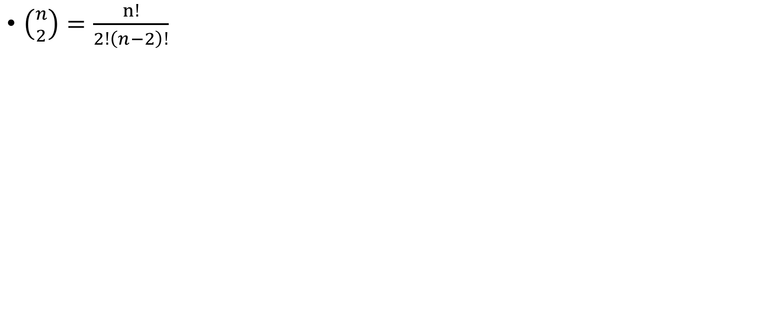
Very Complex Laplacian Matrix [4]
$\left({n \atop 2}\right)=\frac{n!}{2!\left(n−2\right)!}$

Slide 8
Learning Graphs From A Smooth Signal [5]
Not Using the smoothness and time series properties
Learning the Laplacian as a whole

Slide 9
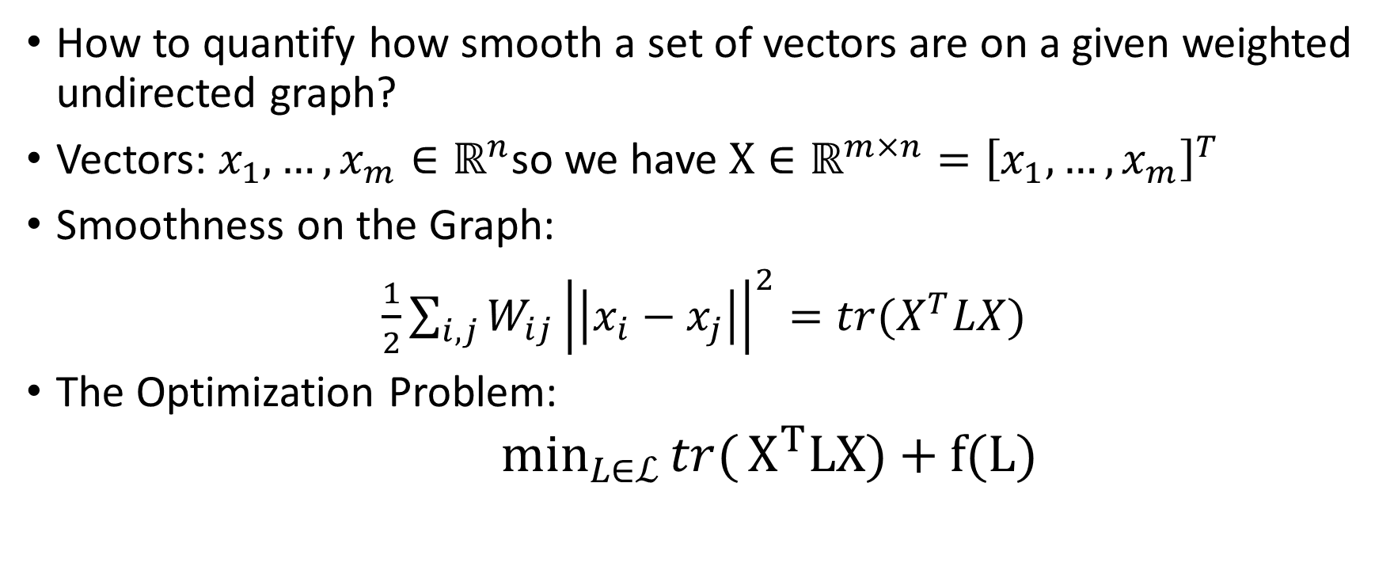
Smoothness On a Graph Definition [5]
How to quantify how smooth a set of vectors are on a given weighted undirected graph?
Vectors: $x_{1}, …, x_{m}∈ℝ^{n}$so we have $X∈ℝ^{m×n}={\left[x_{1}, …, x_{m}\right]}^{T}$
Smoothness on the Graph:
$\frac{1}{2}\sum_{i,j}{W_{ij}}{\left|\left|x_{i}−x_{j}\right|\right|}^{2}=tr(X^{T}LX)$
The Optimization Problem:
$\min_{L∈ℒ}{tr(}X^{T}LX)+f(L)$

Slide 10
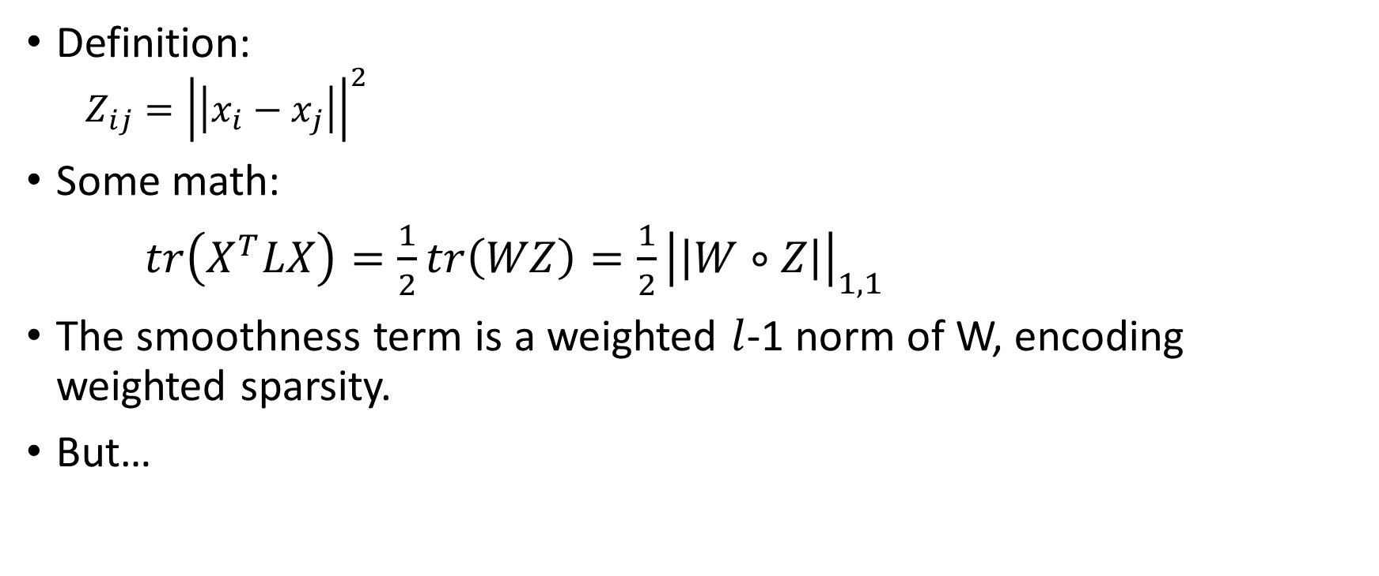
Pairwise Distance Matrix [5]
Definition:
$$Z_{ij}={\left|\left|x_{i}−x_{j}\right|\right|}^{2}$$
Some math:
$tr\left(X^{T}LX\right)=\frac{1}{2}tr\left(WZ\right)=\frac{1}{2}{\left|\left|W∘Z\right|\right|}_{1,1}$
The smoothness term is a weighted $l$-1 norm of W, encoding weighted sparsity.
But…

Slide 11
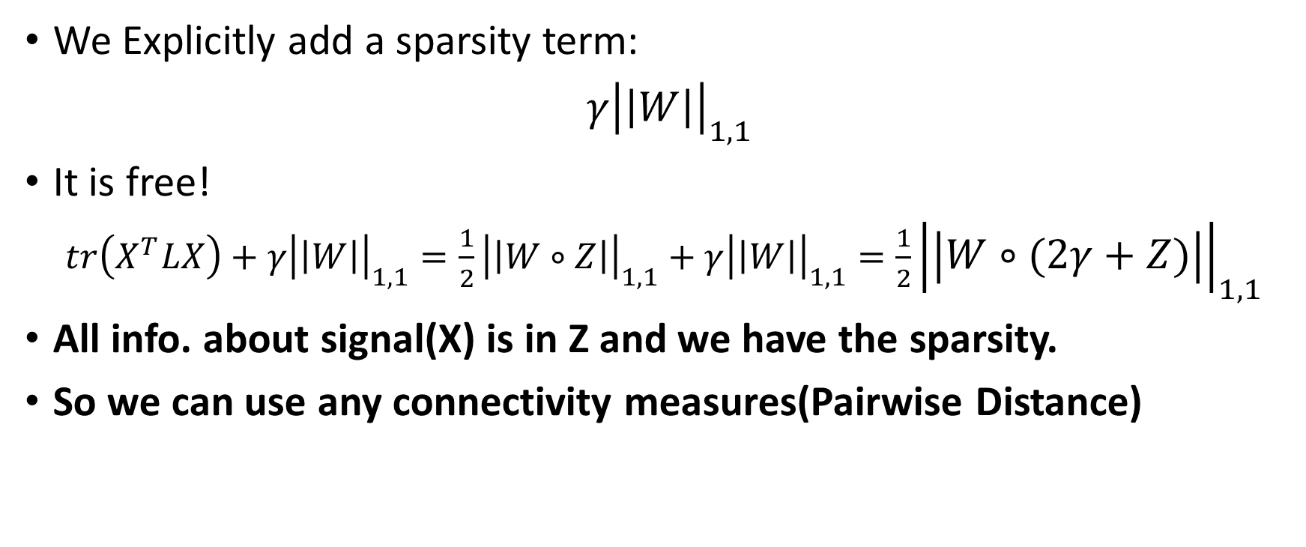
Building a Sparse Laplacian [5]
We Explicitly add a sparsity term:
$γ{\left|\left|W\right|\right|}_{1,1}$
It is free!
$tr\left(X^{T}LX\right)+γ{\left|\left|W\right|\right|}_{1,1}=\frac{1}{2}{\left|\left|W∘Z\right|\right|}_{1,1}+γ{\left|\left|W\right|\right|}_{1,1}=\frac{1}{2}{\left|\left|W∘(2γ+Z)\right|\right|}_{1,1}$
All info. about signal(X) is in Z and we have the sparsity.
So we can use any connectivity measures(Pairwise Distance)

Slide 12
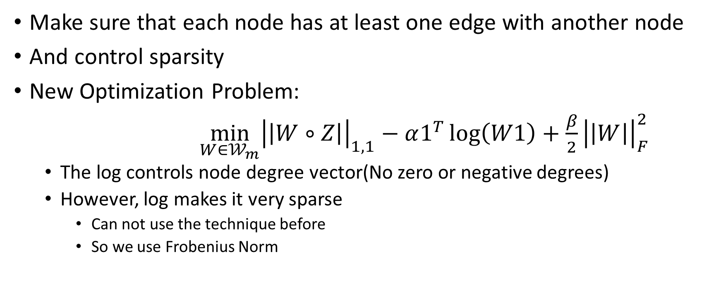
Other Constraint [5]
Make sure that each node has at least one edge with another node
And control sparsity
New Optimization Problem:
$\min_{W∈𝒲_{m}}{{\left|\left|W∘Z\right|\right|}_{1,1}}−α1^{T}\log\left(W1\right)+\frac{β}{2}{\left|\left|W\right|\right|}_{F}^{2}$
The log controls node degree vector(No zero or negative degrees)
However, log makes it very sparse
Can not use the technique before
So we use Frobenius Norm

Slide 13
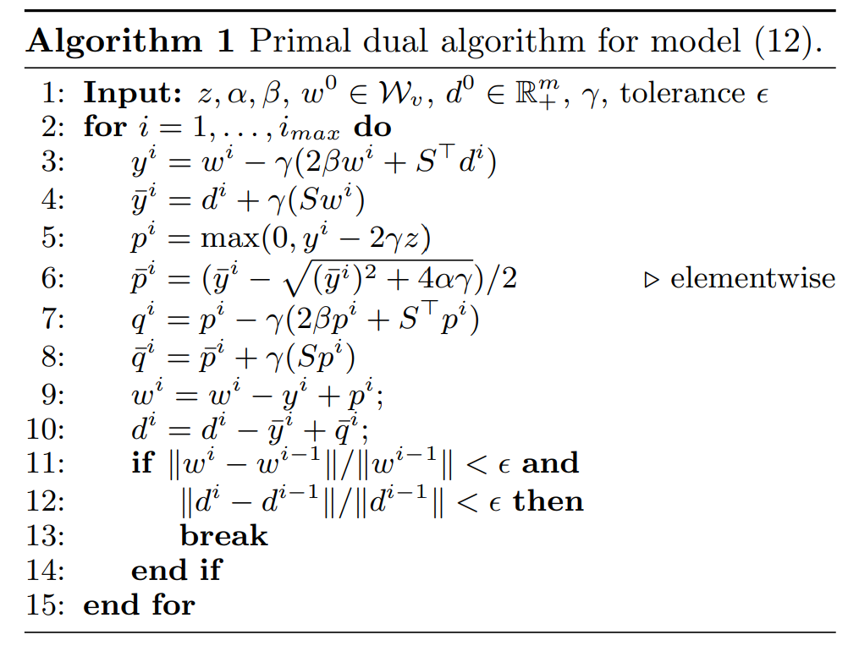
Convex Optimization [5][6]
Blah, Blah, Blah

Slide 14
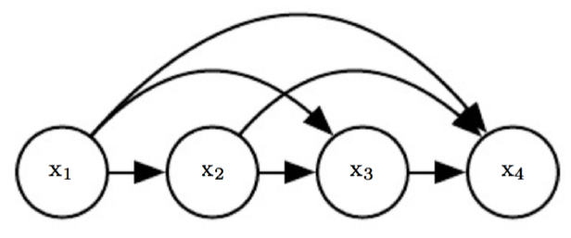

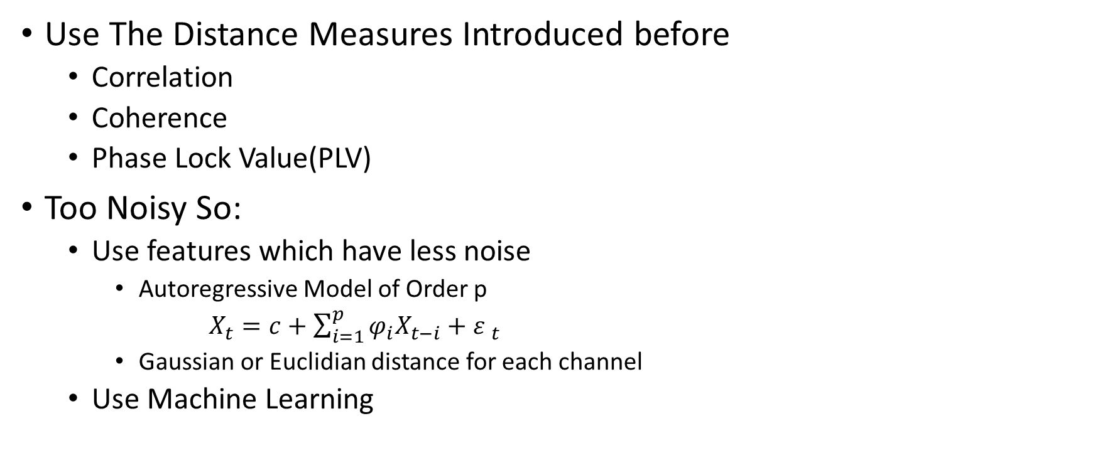
Building the Pairwise Distance Matrix(Z) [7]
Use The Distance Measures Introduced before
Correlation
Coherence
Phase Lock Value(PLV)
Too Noisy So:
Use features which have less noise
Autoregressive Model of Order p
$X_{t}=c+\sum_{i=1}^{p}{φ_{i}X_{t−i}}+{ε }_{t}$
Gaussian or Euclidian distance for each channel
Use Machine Learning

Slide 15
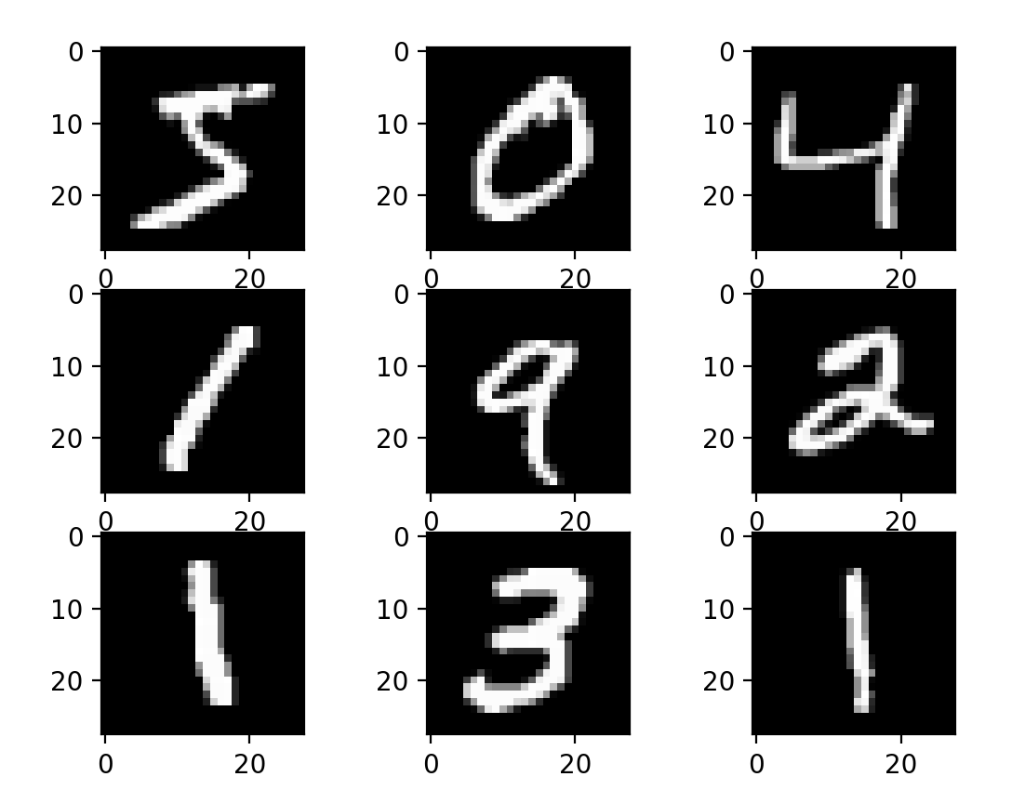
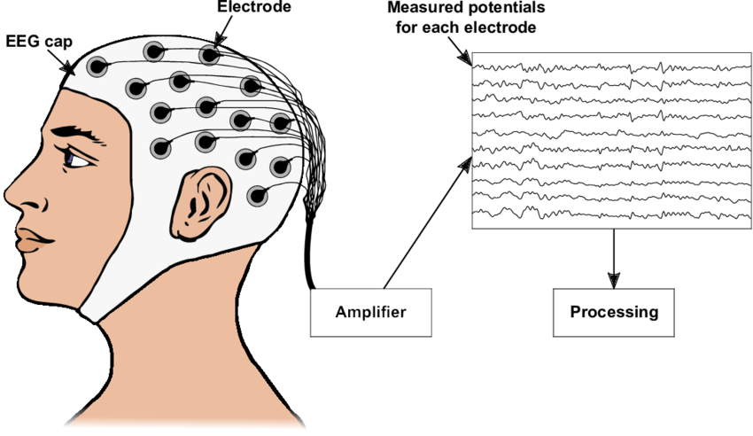
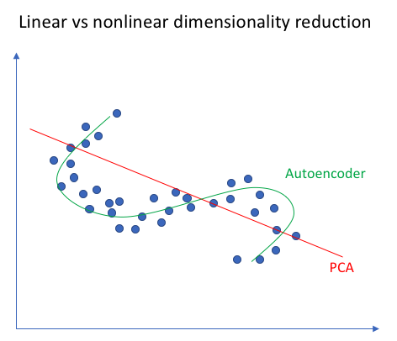
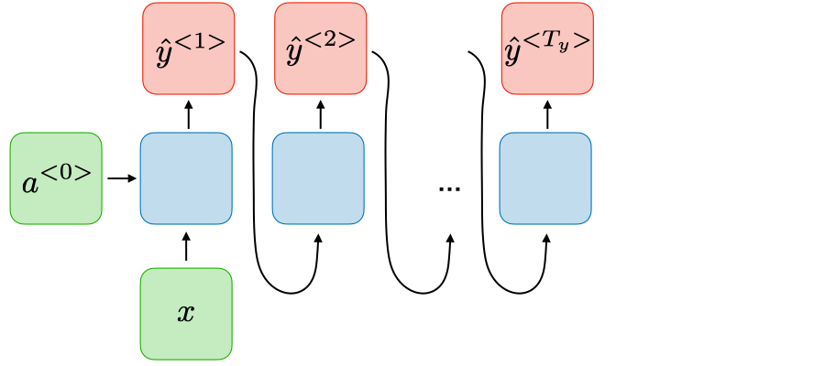
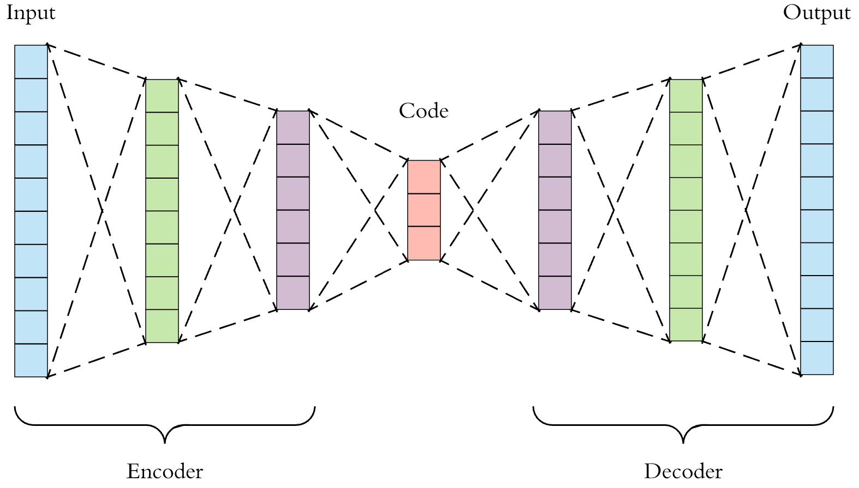
Autoencoders [8][13]
What is a Autoencoder
Feature Extractor: An Example
A Non Linear Feature Extraction Technique
A Deep Neural Network
Unsupervised
The MSE of input is the Loss
Use Recurrent Structures
LSTM
Transformers
One for each channel?
I think yes, Because of the different statistical properties of brain regions

Slide 16
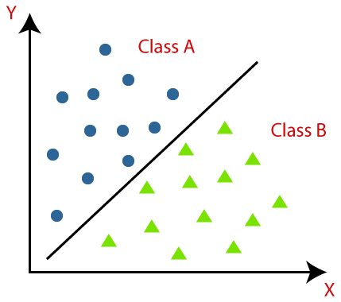
Testing Criteria [10]
Accuracy of a Classifier Using Cross Validation
Support Vector Machine(SVM)
Neural Network
Decision Tree

Slide 17
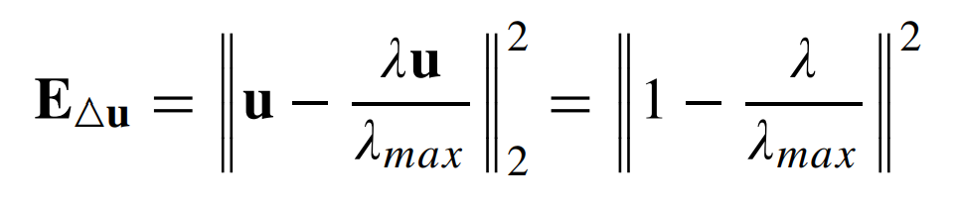
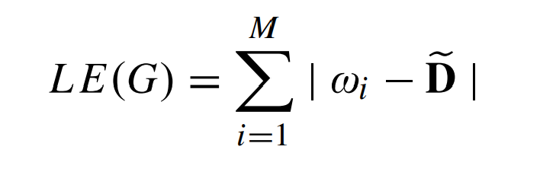
Graph Features [12]
Laplacian Matrix Elements
Two Norm Total Variation of Eigen Vector(TNTV)
Graph Laplacian Energy (GLE)
D = 2E/M, E is number of edges and M being the number of nodes of graph.

Slide 18
Graph Features
Much more! [9][10]
Degree: number of links connected to a node
Shortest path length: a basis for measuring integration
Global efficiency
Transitivity
Participation coefficient
Average neighbor degree
Etc.

Slide 19
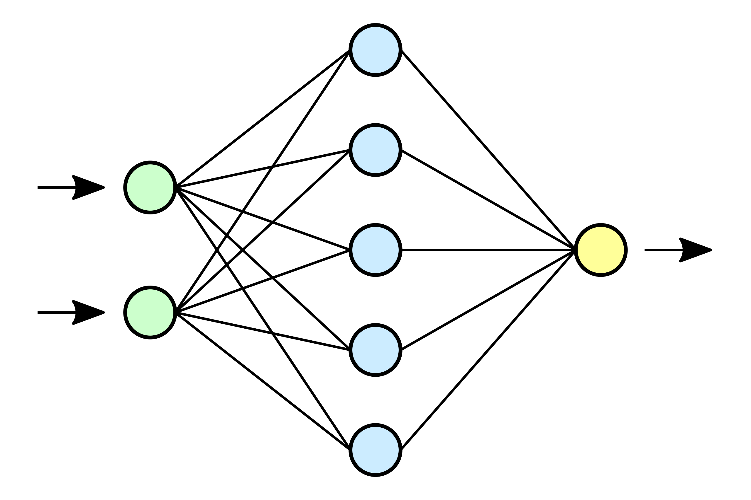
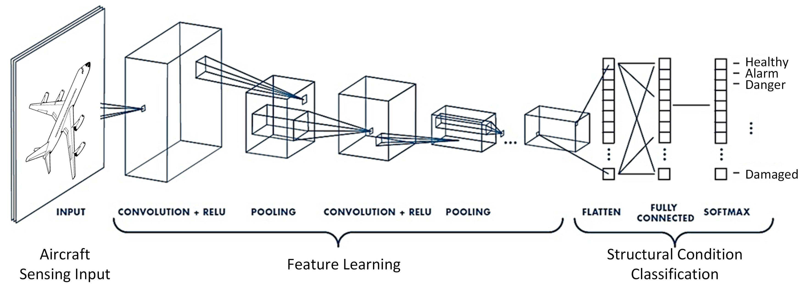
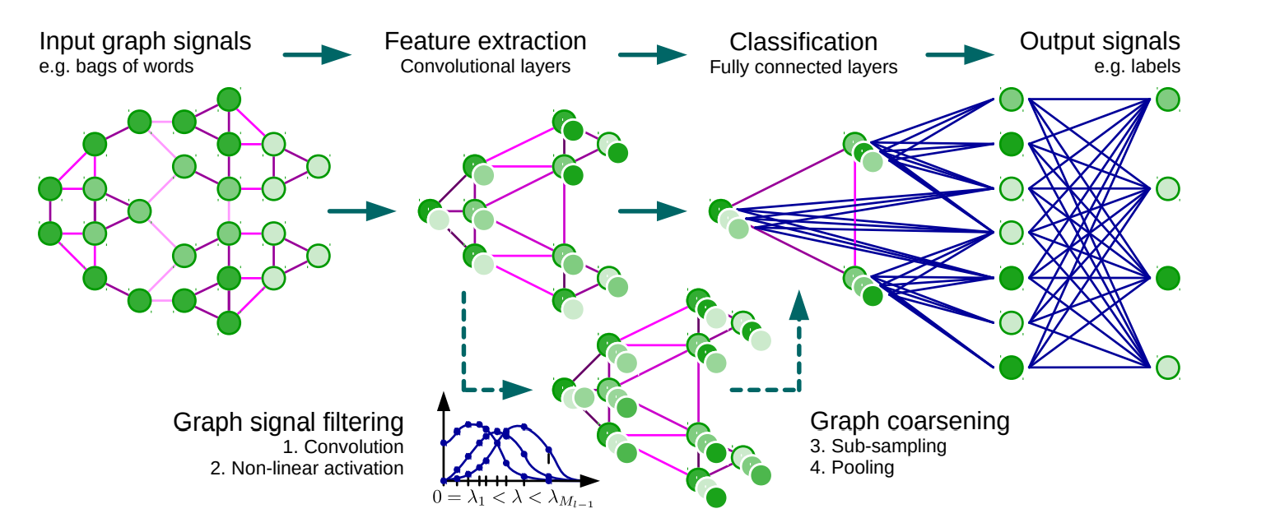
Graph Neural Network(GNN) [14][15][16]
Convolutional Neural Networks
Instead of multiplication they do filtering
We could do this filtering in Graph Domain
Convolutional Neural Networks in Graph Domain for Graph Classification
Much more details
Convolution is for a graph signal
not a graph ☹
Classify each node then FC
Classify by Convolution on
Fourier Basis then FC
Normal Neural Network
Convolutional Neural Network

Slide 20
References
Hajipour Sardouie, Sepideh. " EEG Signal Processing Course Notes." Sharif University of Technology(2022). [1]
Amini, Arash A. " Graph Signal Processing Course Notes." Sharif University of Technology(2021). [2]
Wendling, Fabrice, et al. "From EEG signals to brain connectivity: a model-based evaluation of interdependence measures." Journal of neuroscience methods 183.1 (2009): 9-18. [3]
López, Rafae Lemuz, et al. "Graph theory for brain connectivity characterization from EEG." 2020 10th International Symposium on Signal, Image, Video and Communications (ISIVC). IEEE, 2021. [4]
Kalofolias, Vassilis. "How to learn a graph from smooth signals." Artificial Intelligence and Statistics. PMLR, 2016. [5]
Kalofolias, Vassilis, and Nathanaël Perraudin. "Large scale graph learning from smooth signals." arXiv preprint arXiv:1710.05654 (2017). [6]
Einizade, Aref, et al. "Neural decoding of imagined speech from EEG signals using the fusion of graph signal processing and graph learning techniques." Neuroscience Informatics 2.3 (2022): 100091. [7]
Yu, Wennian, Il Yong Kim, and Chris Mechefske. "Analysis of different RNN autoencoder variants for time series classification and machine prognostics." Mechanical Systems and Signal Processing 149 (2021): 107322. [8]
Rubinov, Mikail, and Olaf Sporns. "Complex network measures of brain connectivity: uses and interpretations." Neuroimage 52.3 (2010): 1059-1069. [9]
Sen, Bhaskar, et al. "Classification of obsessive-compulsive disorder from resting-state fMRI." 2016 38th Annual International Conference of the IEEE Engineering in Medicine and Biology Society (EMBC). IEEE, 2016. [10]
Saboksayr, Seyed Saman, Gonzalo Mateos, and Mujdat Cetin. "EEG-based emotion classification using graph signal processing." ICASSP 2021-2021 IEEE International Conference on Acoustics, Speech and Signal Processing (ICASSP). IEEE, 2021. [11]
Mathur, Priyanka, and Vijay Kumar Chakka. "Graph Signal Processing Based Cross-Subject Mental Task Classification Using Multi-Channel EEG Signals." IEEE Sensors Journal 22.8 (2022): 7971-7978. [12]
Sharifi Zarchi, Ali and Azarkhalili, Behrooz. " Introduction to Machine Learning Course Notes." Sharif University of Technology(2022). [13]
Zhou, Jie, et al. "Graph neural networks: A review of methods and applications." AI Open 1 (2020): 57-81. [14]
Defferrard, Michaël, Xavier Bresson, and Pierre Vandergheynst. "Convolutional neural networks on graphs with fast localized spectral filtering." Advances in neural information processing systems 29 (2016). [15]
Kipf, Thomas N., and Max Welling. "Semi-supervised classification with graph convolutional networks." arXiv preprint arXiv:1609.02907 (2016). [16]
Behrouzi, Tina, and Dimitrios Hatzinakos. "Graph variational auto-encoder for deriving EEG-based graph embedding." Pattern Recognition 121 (2022): 108202.[17]

Slide 21
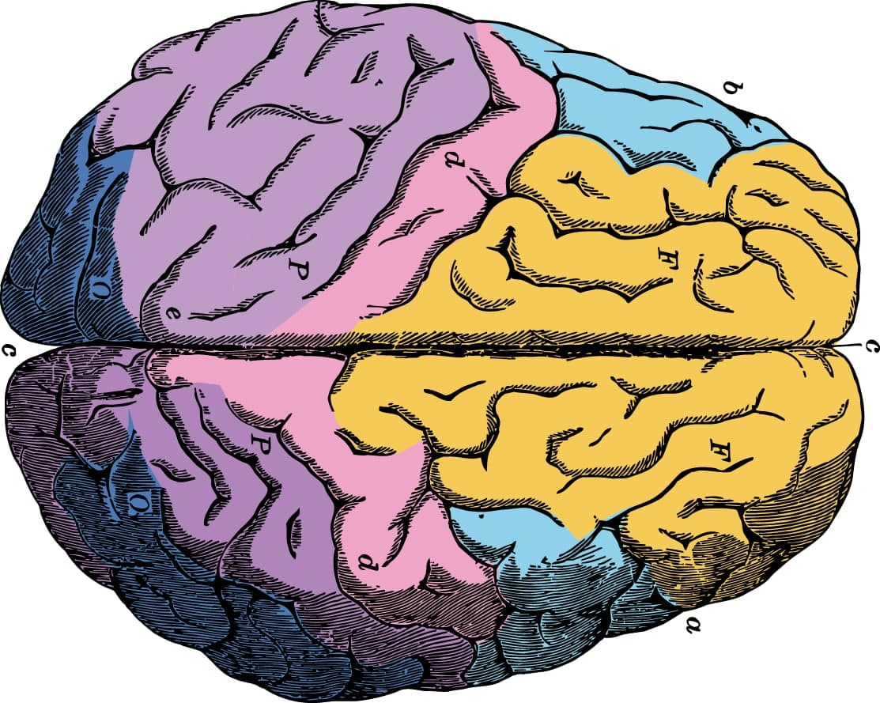
Thanks for Your Attention!

